Slide 1
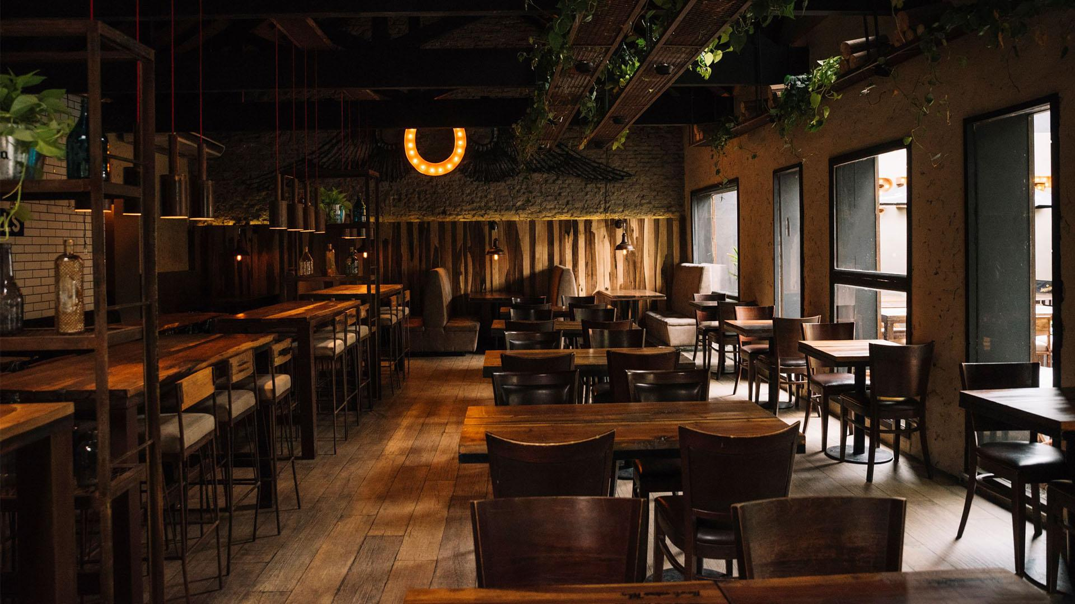
Hackathon Presentation IE6600_Sec05_Group16_Hackathon Akilesh Vishnu Mohan Raj & Ravi Patel

Slide 2


Topic: Restaurants Health Score Data in San Francisco

Slide 3
Note: -- The Dataset is very Dynamic with lots of variables and we can do a lot of analysis based on what issue we decide to address. -- Thus we are focusing on a Particular goal and driving the presentation towards addressing on the below Idea Risk Metrix of Restaurants in San Francisco (2016 – 2019)

Slide 4
CONTENTS :
Here’s what you’ll find through the presentation:
An Analysis of Total Restaurants in San Francisco and how it has grown over years.
Analysis on the Risk Categories.
Analysis of Total Restaurants Vs Violated Restaurants over the years.
Major Reasons for Violations
Conclusion: How have the Restaurants fared over the years. Quality has increased or Decreased.

Slide 5


01
An Analysis of Total Restaurants in San Francisco and how it has grown over years.

Slide 6
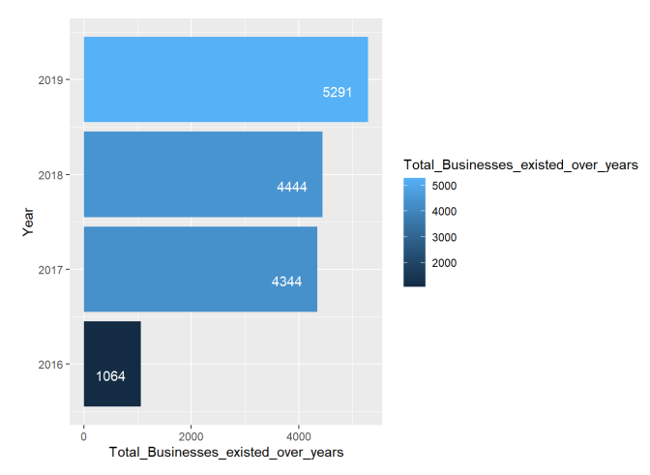
Total count of restaurants in San Francisco over the years.
The Total number of Restaurants in the city of San Francisco has continuously been increasing over the years.
There has been a drastic spike in the restaurant between the years 2016-2017.
Other years the number of restaurants has been gradually growing.

Slide 7
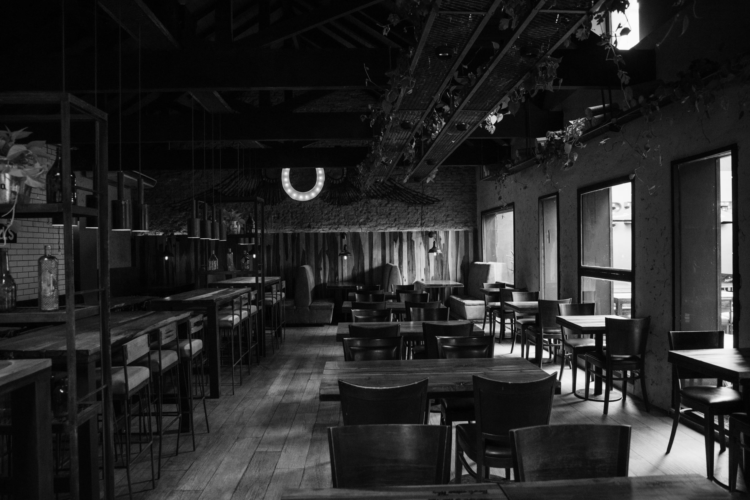
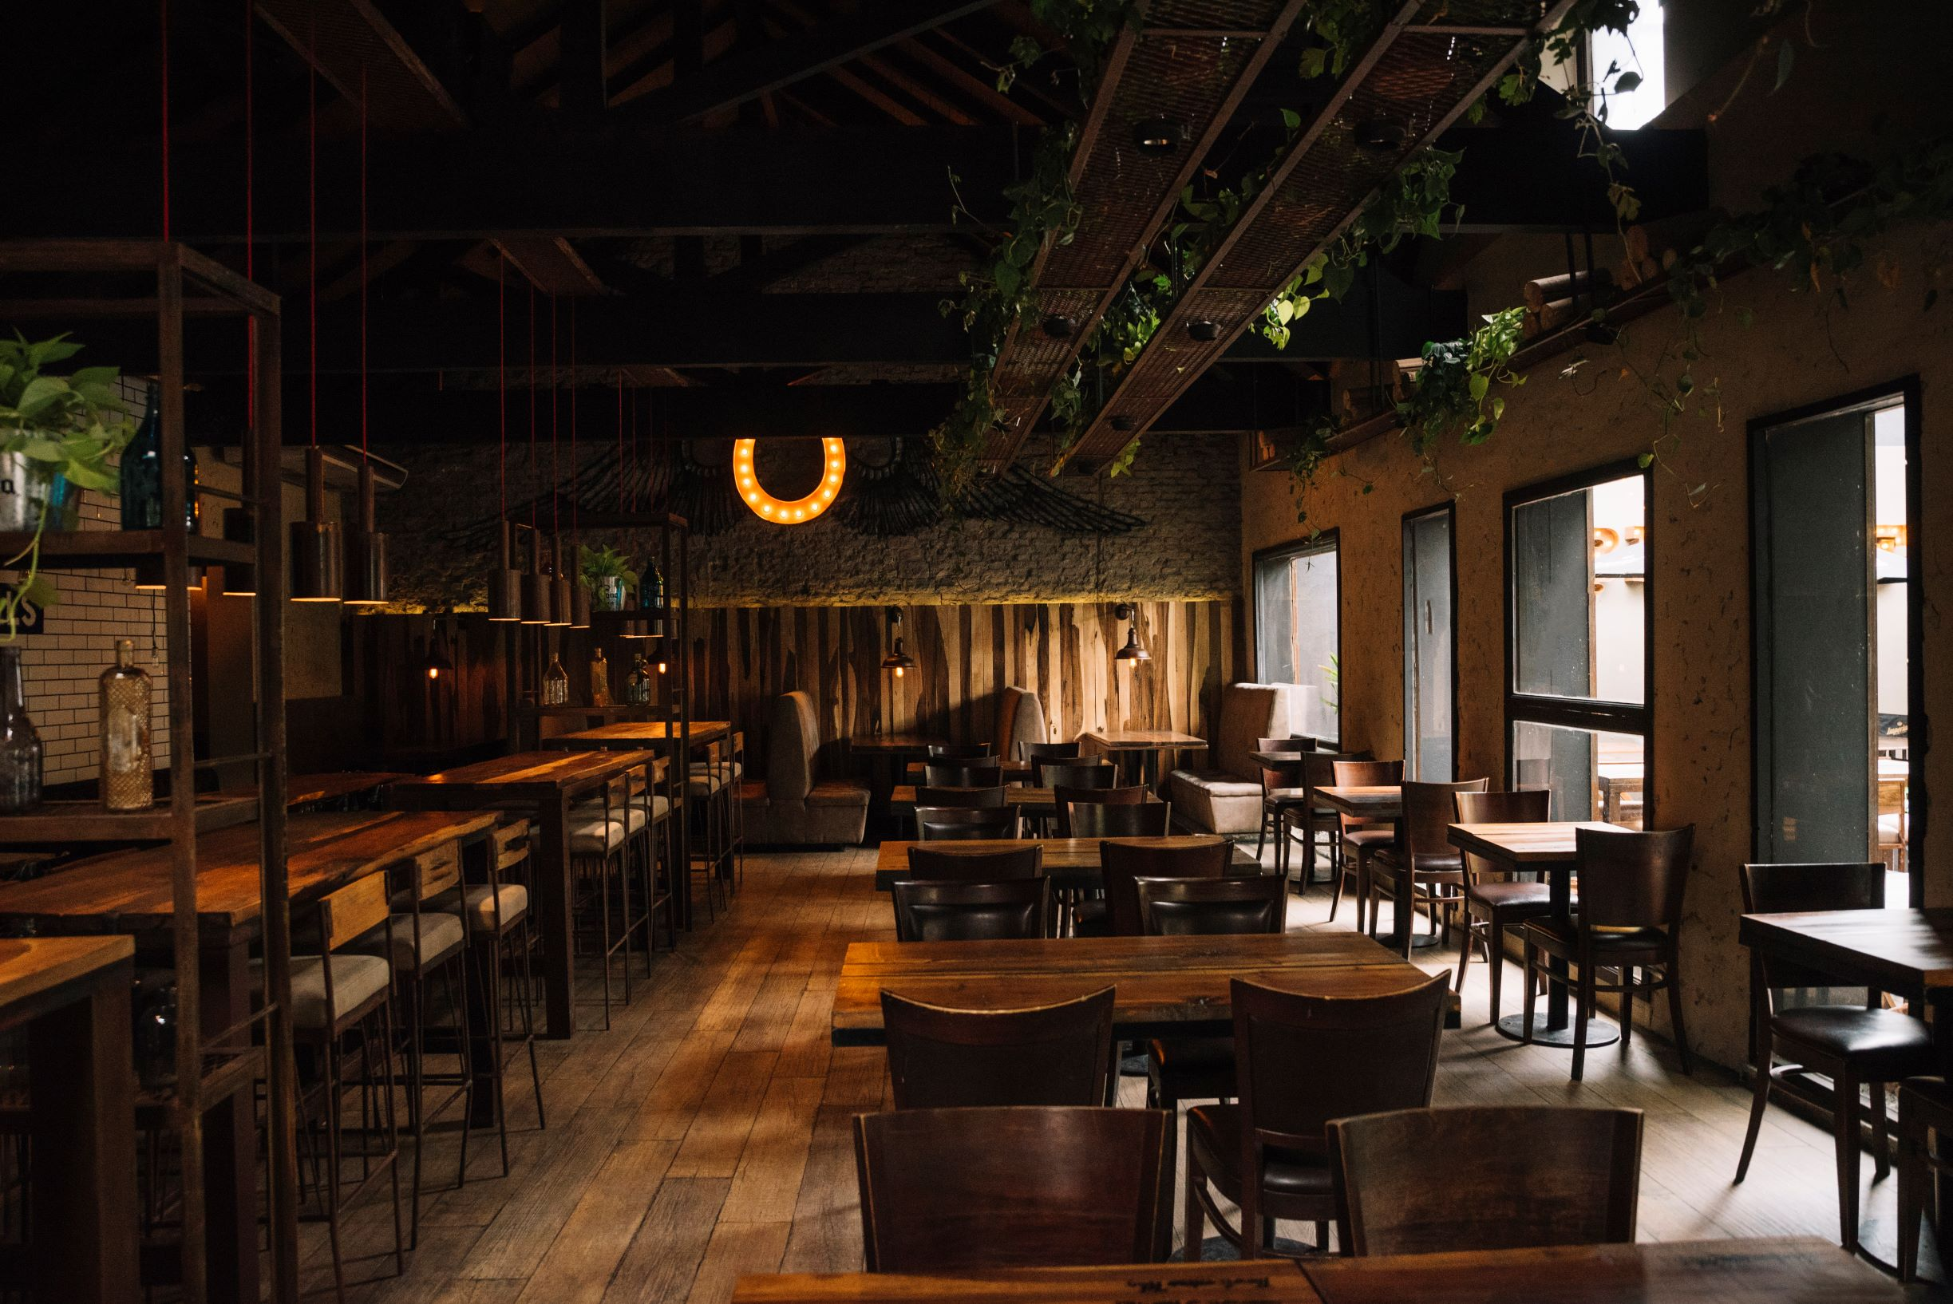
02
Analysis on the Risk Categories.

Slide 8
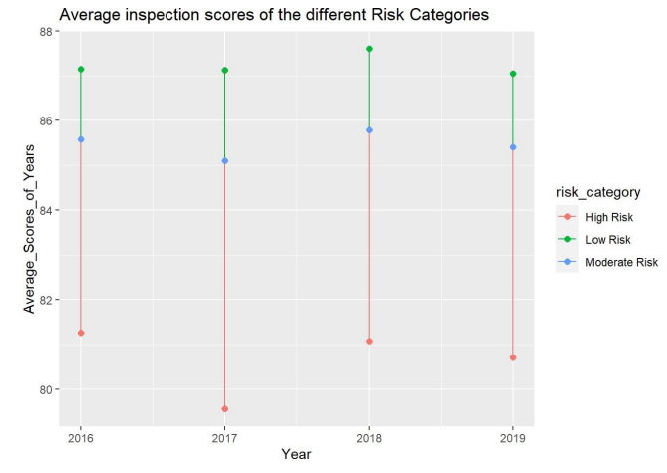
Average Violation scores of the various risk categories over the years (2016- 2019)
There 3 risk categories classified as
High Risk
Moderate Risk
Low Risk
We can observe the change in average inspection over various risk categories.

Slide 9
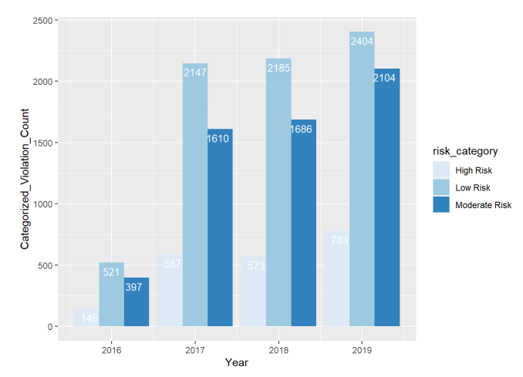
Violations categorized for restaurants across years.
Analyzing the count of restaurants categorized by risk from years 2016-2019.
We can observe that there is steady increase in the number of restaurants under each category.

Slide 10


03
Analysis of
Total Restaurants
Vs
Violated Restaurants over the years.

Slide 11
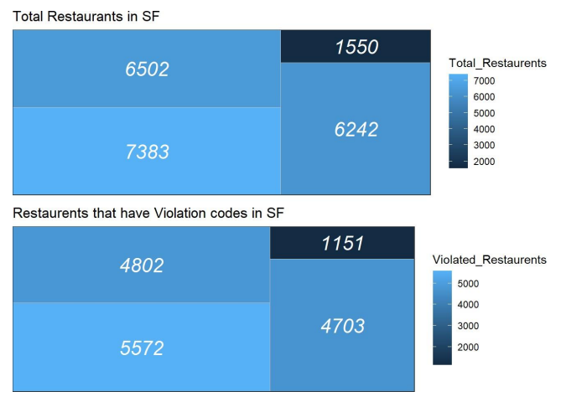
Total number of restaurants and the Total violations categorized across the years.
Categorizing the total number of restaurants from years 2016-2019 to the violated restaurants classified under different risk categories.
The Tree map in the top represents the total number of restaurants and the below one represents the total number of violated restaurants.

Slide 12
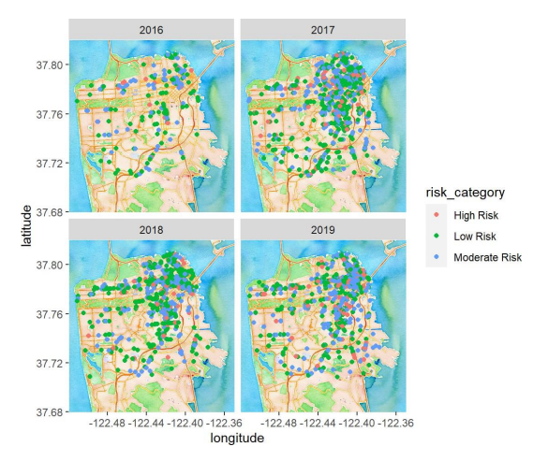
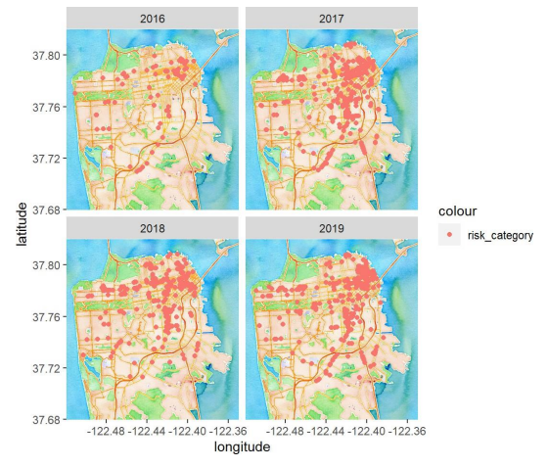
Geographical Mapping of San Francisco for Violations with respect to Risk Category

Slide 13


04
PRODUCT
Major Reasons for Violations

Slide 14
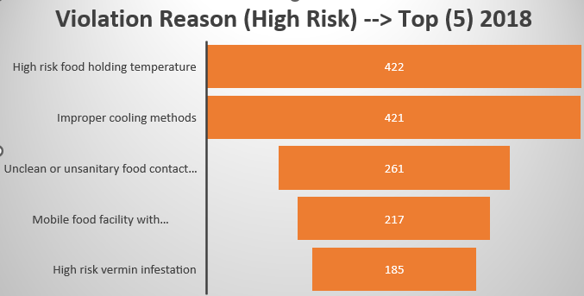
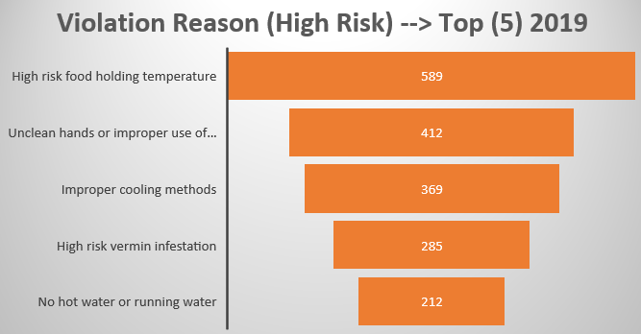
High Risk Category Violation Reasons 2018 Vs 2019

Slide 15


Conclusion: How have the Restaurants fared over the years. Quality has increased or Decreased?
05

Slide 16
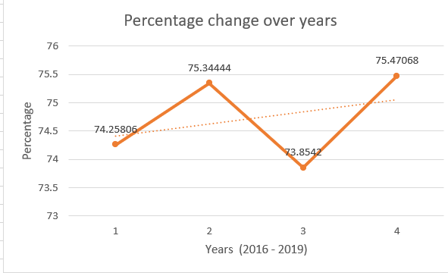
Restaurant Violations over Years
75.47%
Highest Risk – Year (2019)
73.8%
Lowest Risk – Year (2018)

Slide 17
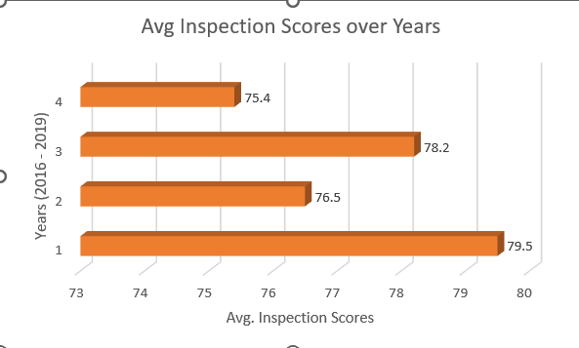
Average Inspection Scores over the years
We can observe that the average scores have been simultaneously dropping low and high.
Low means it is riskier and less safe.
High means it is reliable and safe.
While analyzing the reasons, we see the same reason counts increasing drastically high.
Thus, we can conclude that the restaurants are reluctant on quality as similar reason counts are increasing and decreasing in simultaneous years.

Slide 18

THANK YOU

